Slide 1
GIT
GIT is a distributes revision control and source code management system with an emphasis on speed.
It’s a free software distributes under the terms of GNU General Public License version 2.
VERSION CONTROL SYSTEM:
VCS is a software that helps software developers to work together and maintain a complete history of their work.
There are 2 types of VCS:
1. DVCS (DISTRIBUTED VERSION CONTROL SYSTEM )
Every user has a compete repository which is called as local repository on their local computer.
2. CVCS (CENTRALIZED VERSION CONTROL SYSTEM)
In CVCS, there is only one central repository which is the server.

Slide 2
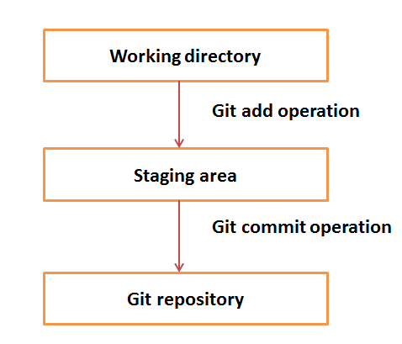
Basic Workflow of Git
The working directory is the place where files are checked out.
After every add operation in git files are stored in the staged area.
Git doesn’t track each and every modified file.
Whenever you do commit an operation, Git looks for the files present in the staging area.
Only those files present in the staging area are considered for commit and not all the modified files.

Slide 3
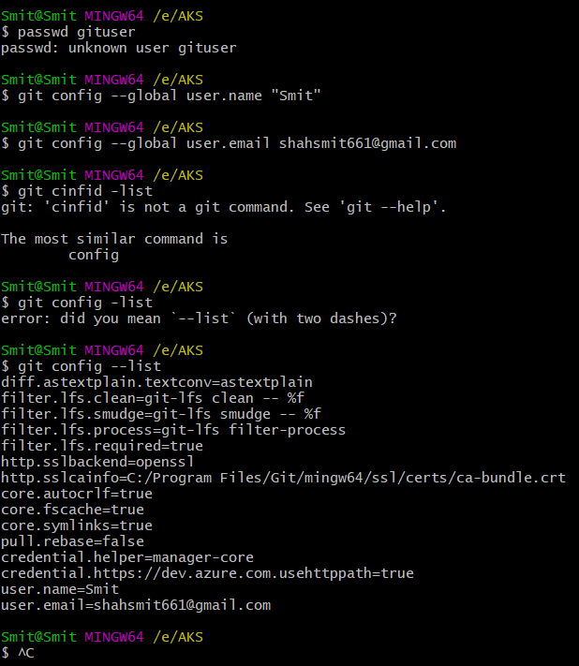
Creating USER NAME and USER E-MAIL
For checking that the username and user e-mail is created or not

Slide 4
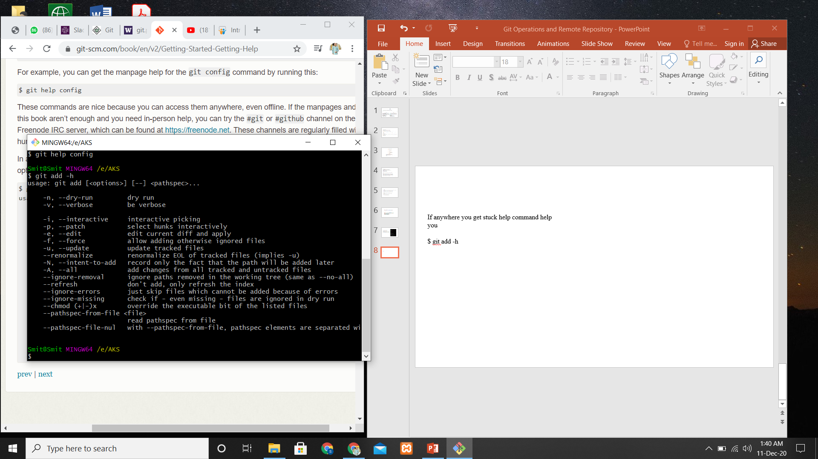
HELP COMMAND

Slide 5
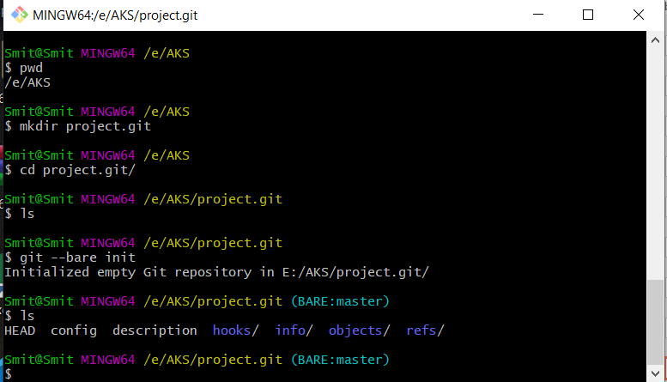
Creating a Bare Repository

Slide 6
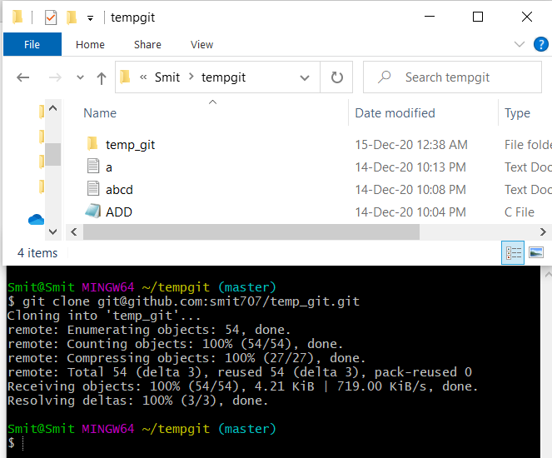
CLONING
Clone operation creates an instance of the remote repository.

Slide 7
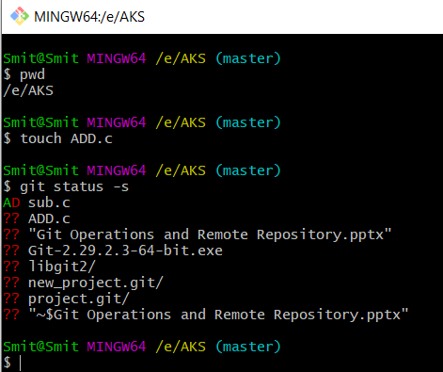
CREATING A NEW FILE

Slide 8
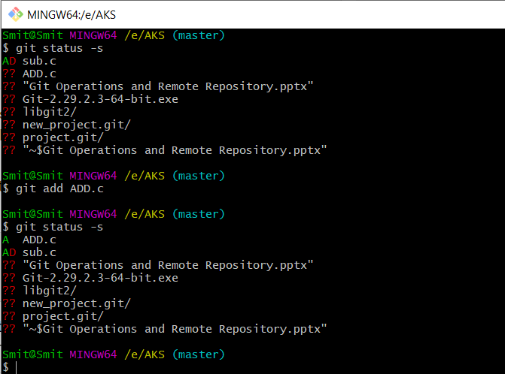
ADDING FILE IN STAGING AREA
Git is showing a question mark before file names. Because these files are not a part of Git, and that is why Git does not know what to do with these files.

Slide 9
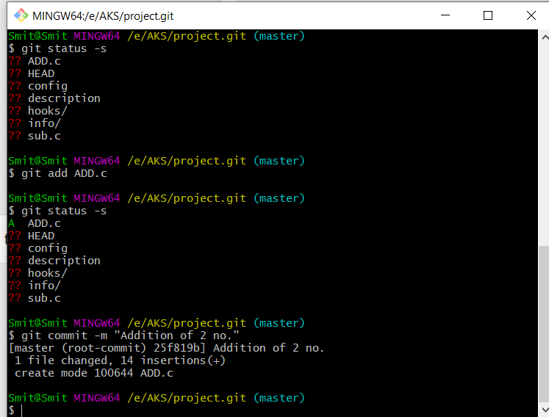
COMMIT COMMAND
The "commit" command is used to save your changes to the local repository

Slide 10
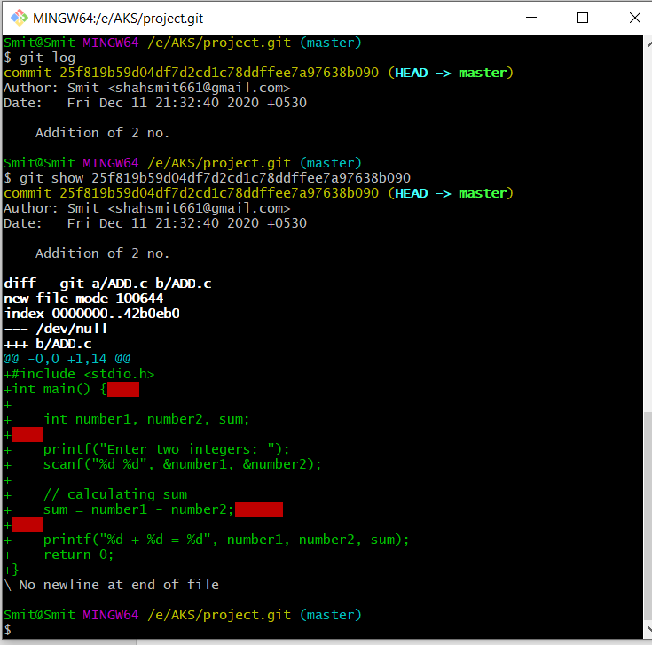
LOG COMMAND
It will display the information of all the commits with their commit ID, commit author, commit date and SHA-1 hash of commit.

Slide 11
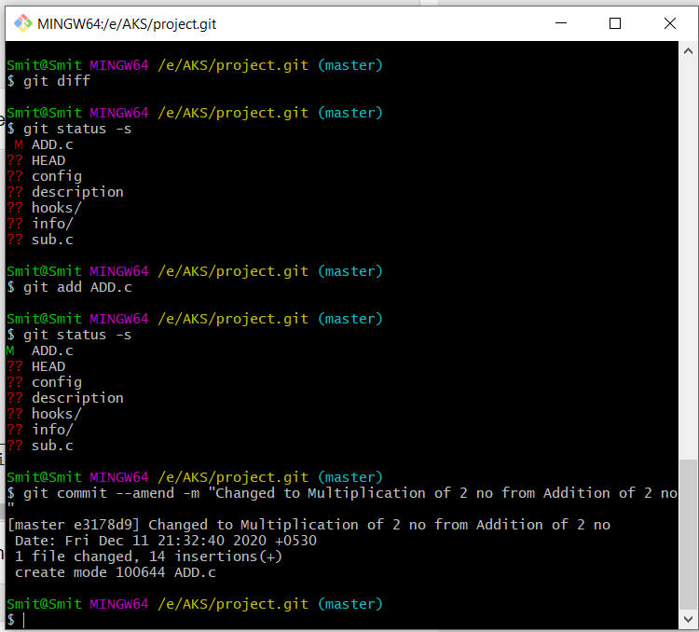
diff
and
amend COMMAND
Diff command - For reviews the changes
Amend - The amend operation changes the last commit including your commit message; it creates a new commit ID.

Slide 12
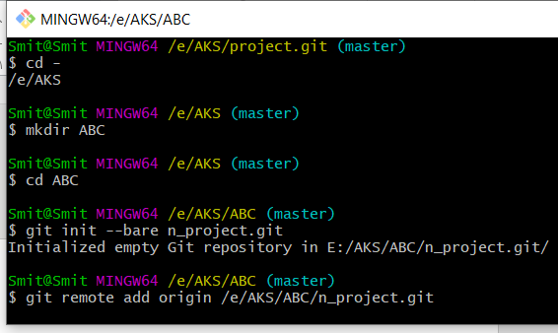
BARE REPOSITORY
It initializes the repository without a working directory. By convention, the bare repository must be named as .git.

Slide 13
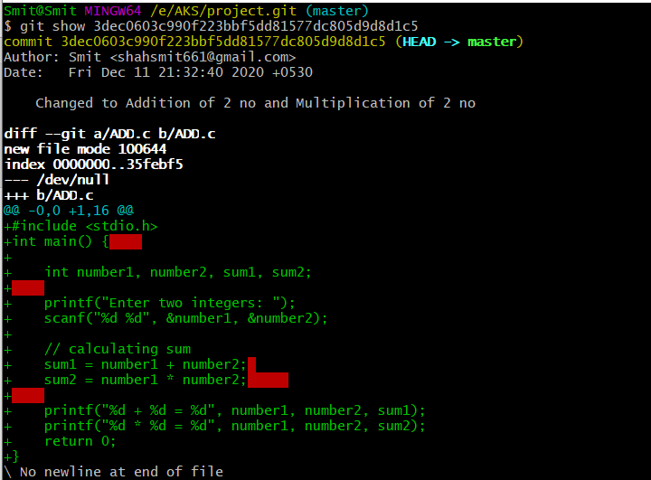
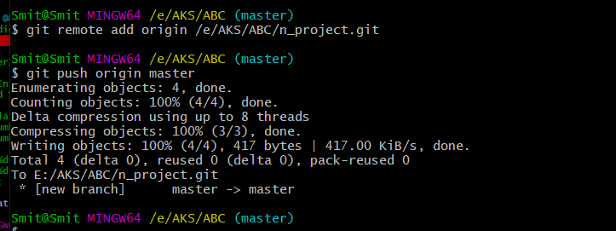
PUSH OPERATION
The Push operation stores data permanently to the Git repository.

Slide 14
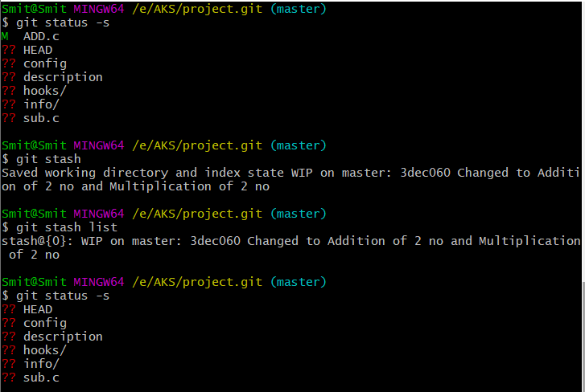
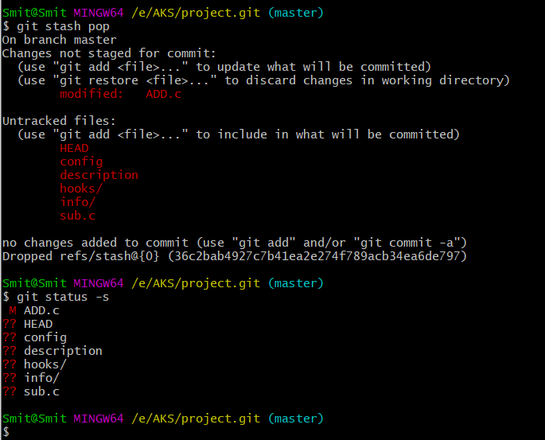
STASH OPERATION
The stash operation takes your modified tracked files, stages changes, and saves them on a stack of unfinished changes that you can reapply at any time.

Slide 15
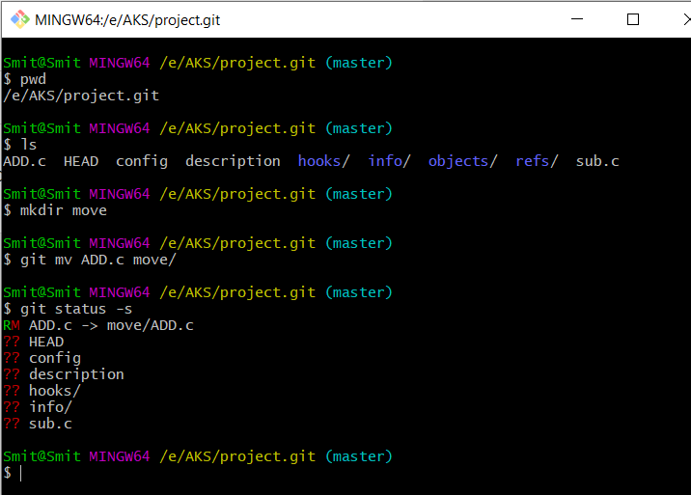
MOVE OPERATION

Slide 16
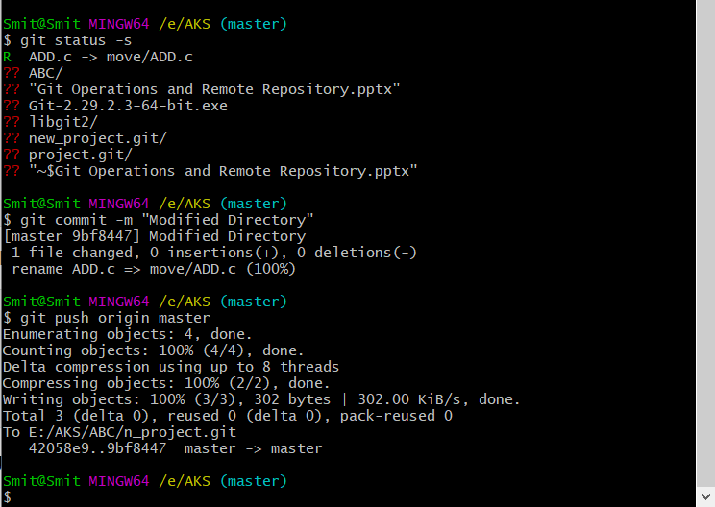
To make Move Operations Permanent

Slide 17
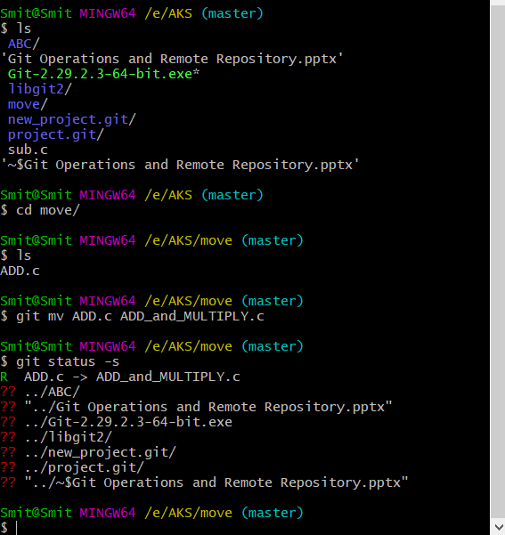
RENAME OPERATION

Slide 18
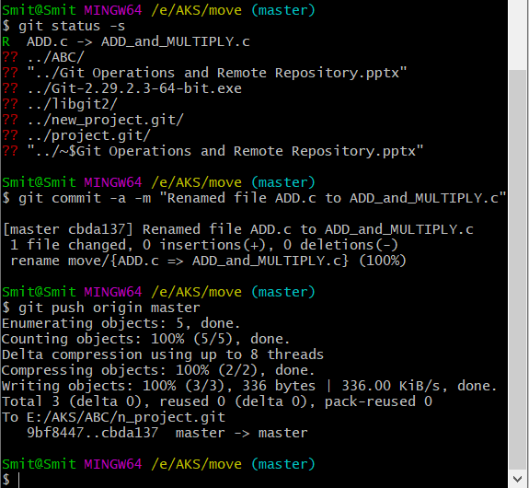
To make Rename Operations Permanent

Slide 19
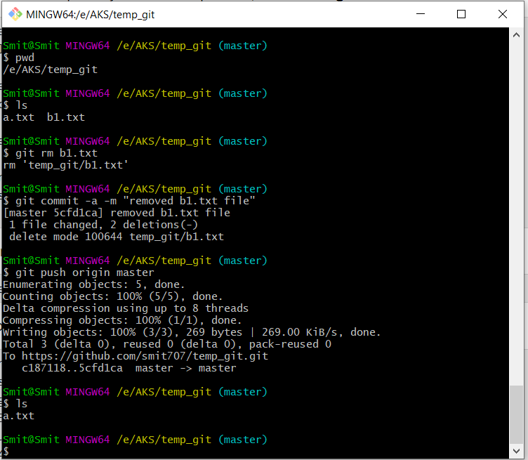
REMOVE/
DELETE OPERATION

Slide 20
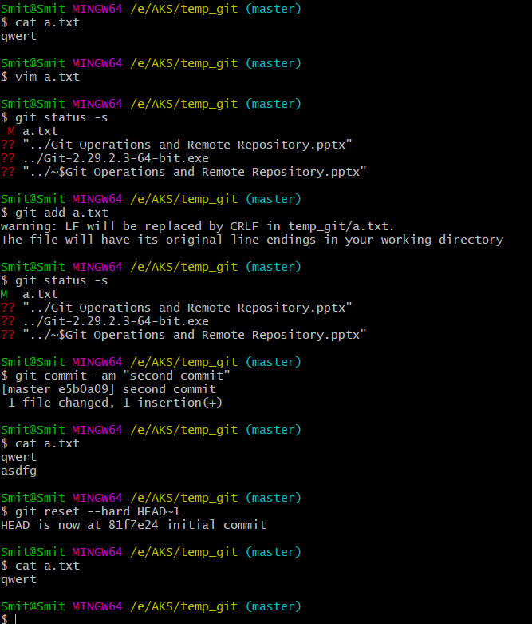
FIX
MISTAKES
Next topic is fix mistake. If you have by mistake inserted some wrong text in your file and commited it so it can be reserved with the help of this command
~
Tilde

Slide 21
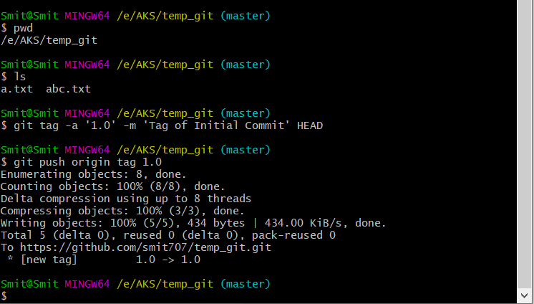
CREATING TAGS
Tags are ref's that point to specific points in Git history It allows giving meaningful names to a specific version in the repository.

Slide 22
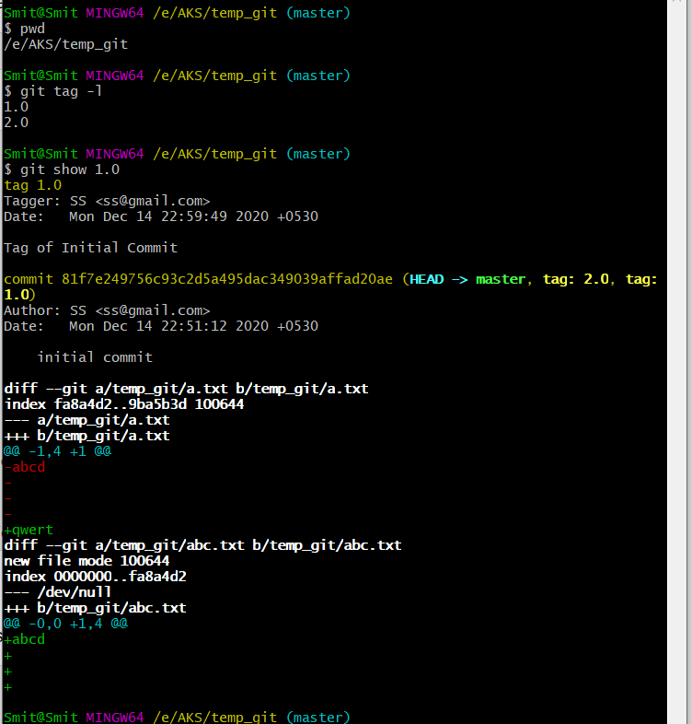
FOR VIEWING TAGS

Slide 23
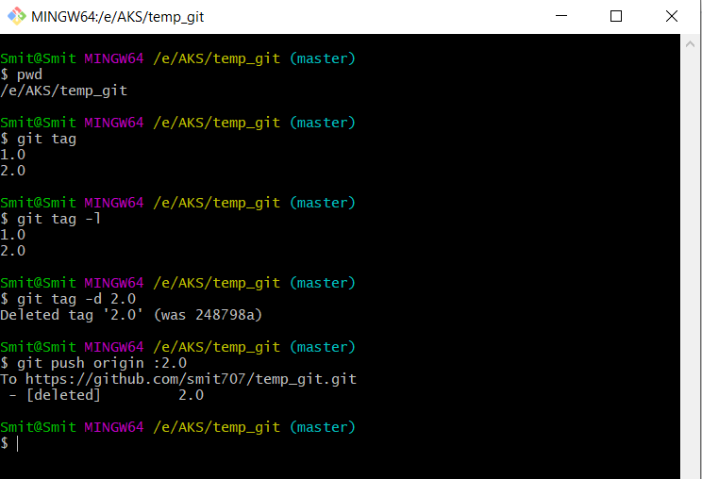
FOR DELETING TAGS

Slide 24
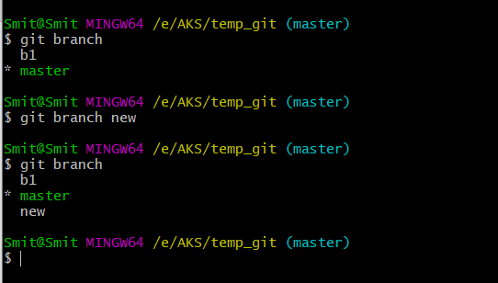
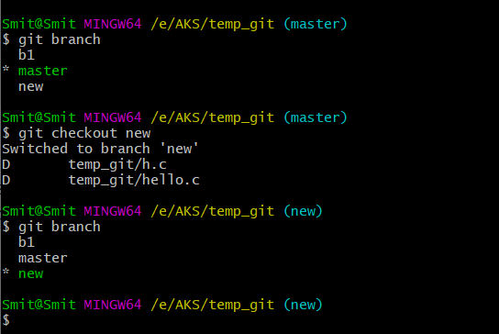
CREATING BRANCH
Branch operation allows creating another line of development. We can use this operation to fork off the development process into two different directions.
SWITCHING BRANCH

Slide 25
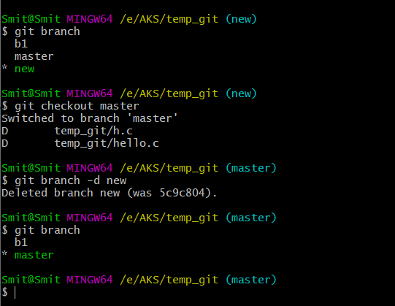
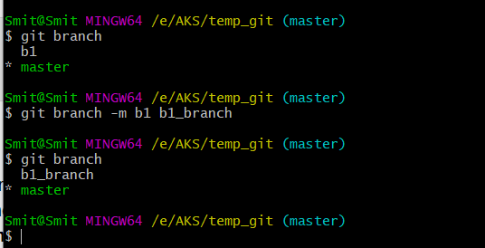
DELETING BRANCH
RENAMING BRANCH

Slide 26
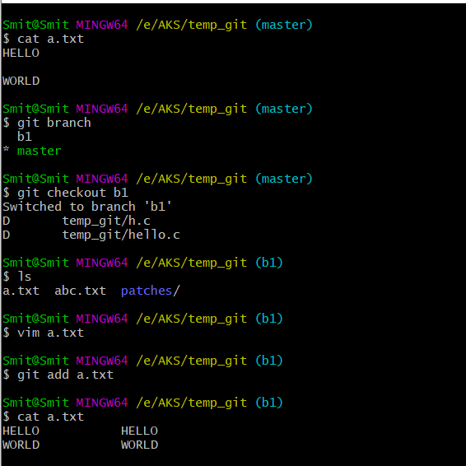
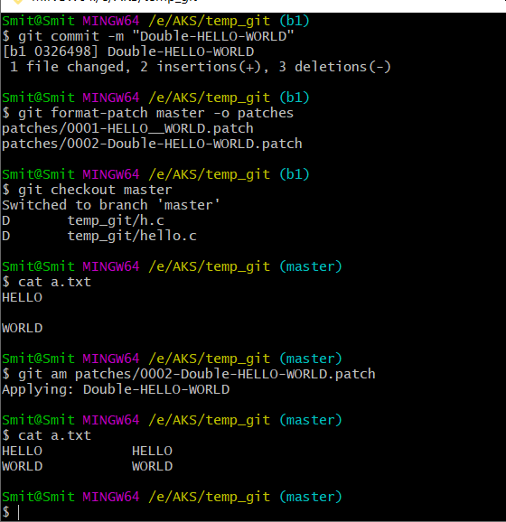
CREATING AND APPLYING PATCH
Patch is a text file, whose contents are similar to Git diff, but along with code, it also has metadata about commits; e.g., commit ID, date, commit message, etc

Slide 27
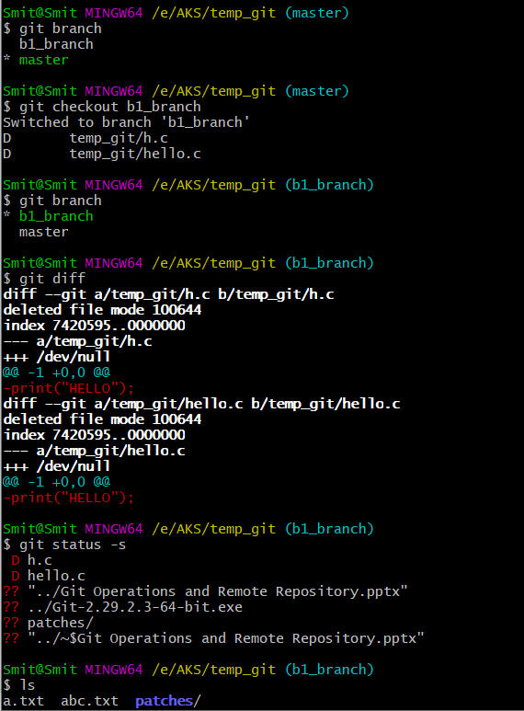
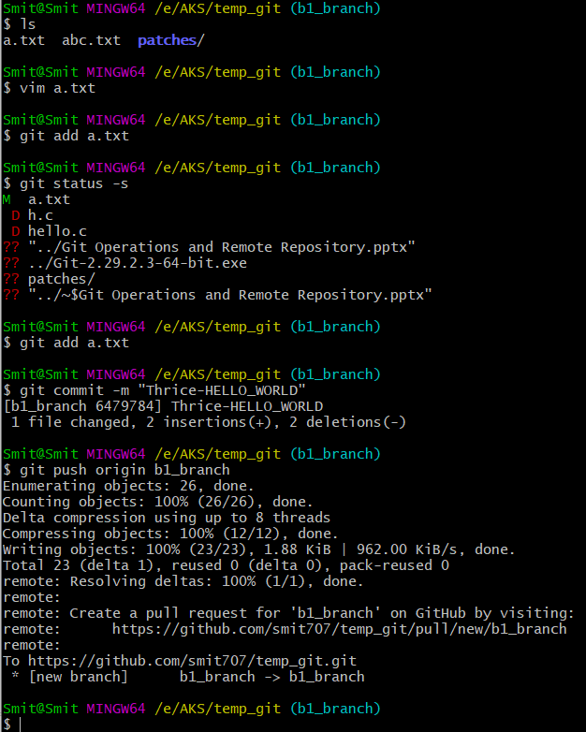
MERGING TWO BRANCHES

Slide 28
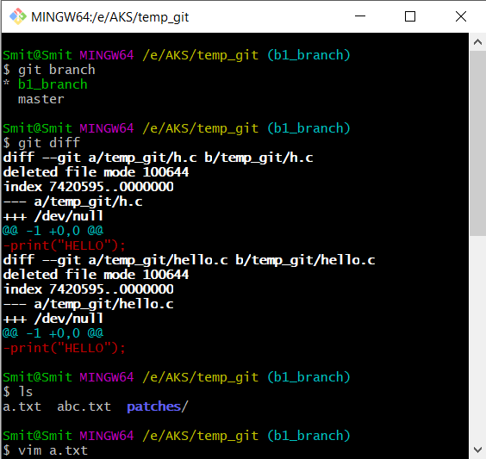
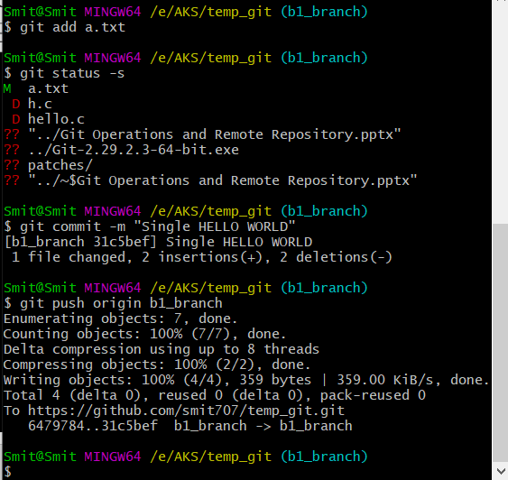
HANDLING CONFLICTS
CHANGES IN b1_branch BRANCH
Suppose we make changes in n_b branch and we make changes in master branch of that same file it creates conflict while the pull operation

Slide 29
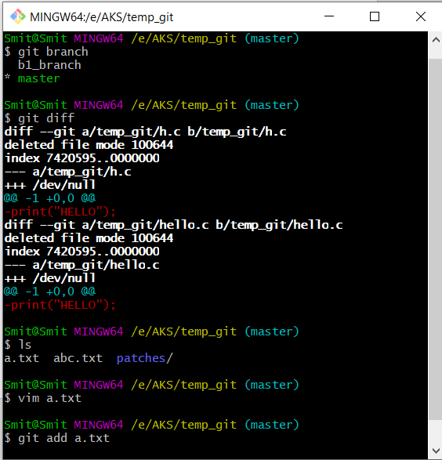
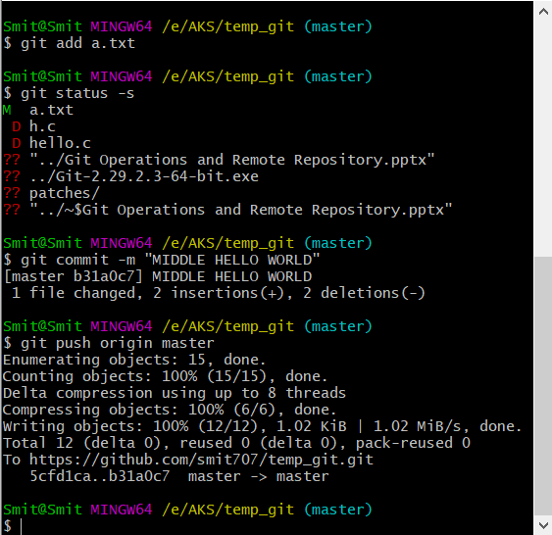
HANDLING CONFLICTS
CHANGES IN master BRANCH

Slide 30
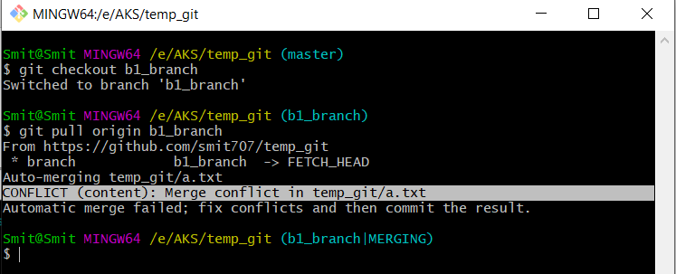
TACKLE CONFLICTS

Slide 31
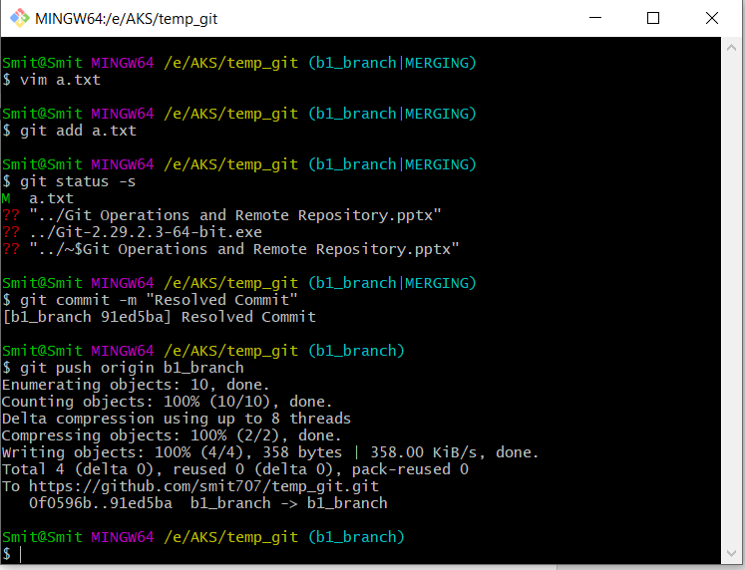
RESOLVE CONFLICTS

Slide 32
THANK YOU

